Slide 1
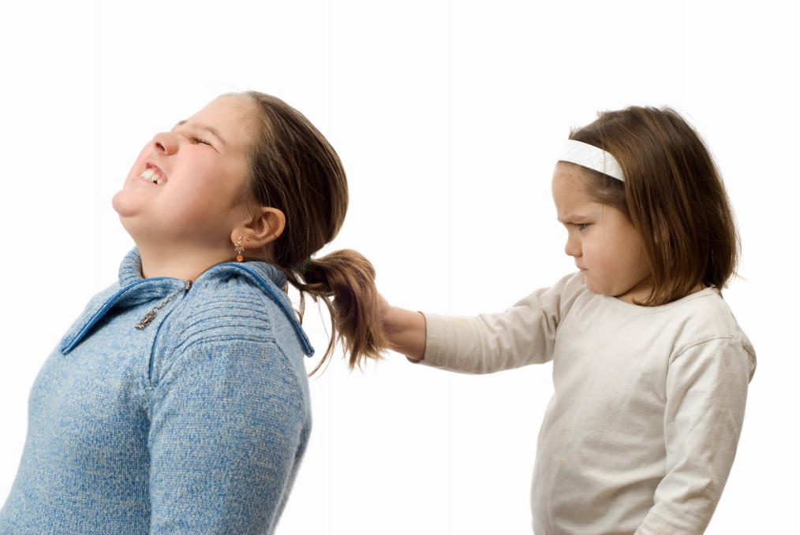
Ameera is pulling Joanne’s hair

Slide 2
Kalista is calling Matt ‘gay’

Slide 3
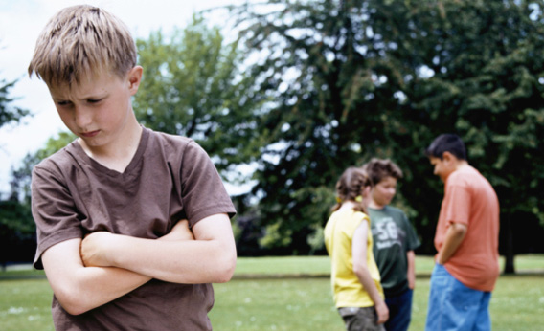
The children won’t play with Stefan

Slide 4
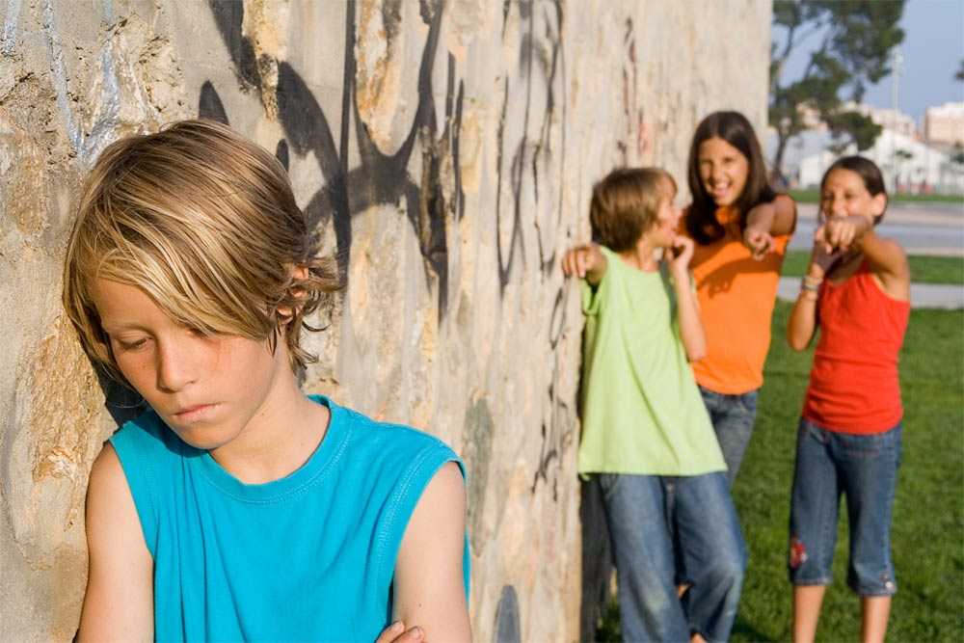
Hannah, Jan and Sam are laughing at Harry

Slide 5
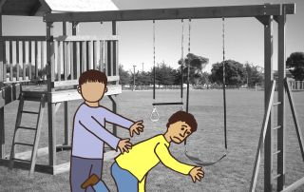
Jason pushes Lewis over

Slide 6
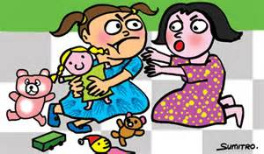
Karina won’t share her toys

Slide 7
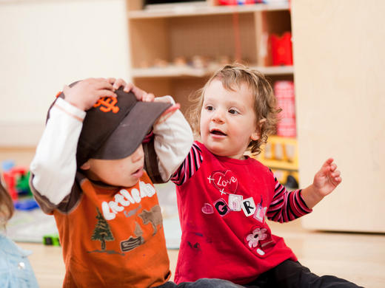
Jen is trying to pull Bill’s cap off

Slide 8
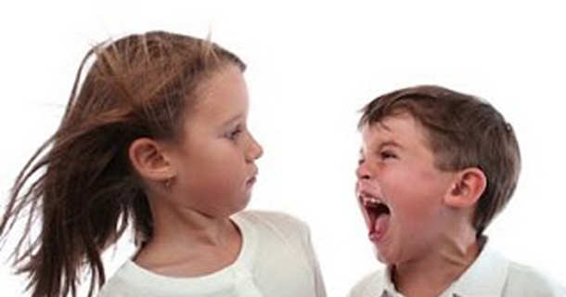
Johnny says Sarah’s Mum is a ‘lezza’

Slide 9
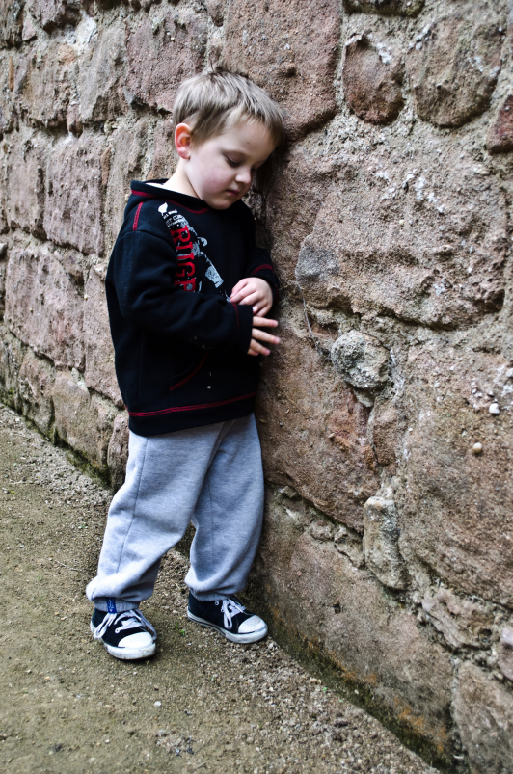
Al won’t share his birthday cake with Samir. Samara and Roisin have hidden Ana’s book bag. Alan tried to pull off Sohalla’s headscarf. Sarah says Karen is stupid because she finds reading hard.

